Slide 1
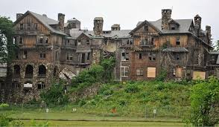
The Collegiate Deathpool
How Private Universities Can Prepare for the Demographic Cliff
CBFA 2025 Spring Symposium
Jim Long, PhD
Professor of Finance and Economics (Tenured)
Division Chair of Business
Friends University

Slide 2
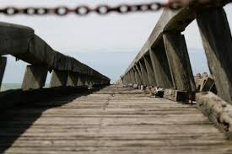
“I thought it was Y2K all over again…”

Slide 3
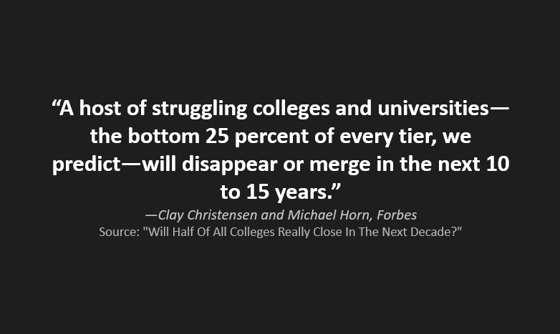

Slide 4




Framing the Problem
Declining Enrollment
Rising Costs
Faith-based institutions face unprecedented challenges in attracting students.
Operational expenses continue to outpace revenue growth.
Accelerating Closures
Post-2020 has seen a dramatic increase in institutional shutdowns.

Slide 5
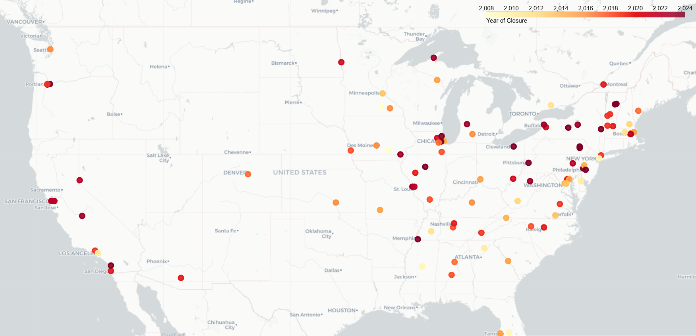
Closed Universities Since 2008

Slide 6
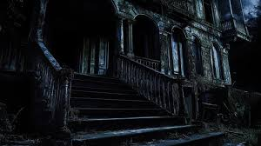
A Growing Wave of Closures
76 Private Universities Closed Since 2016
25% May Not Survive Past 2028
100% Not Random

Slide 7
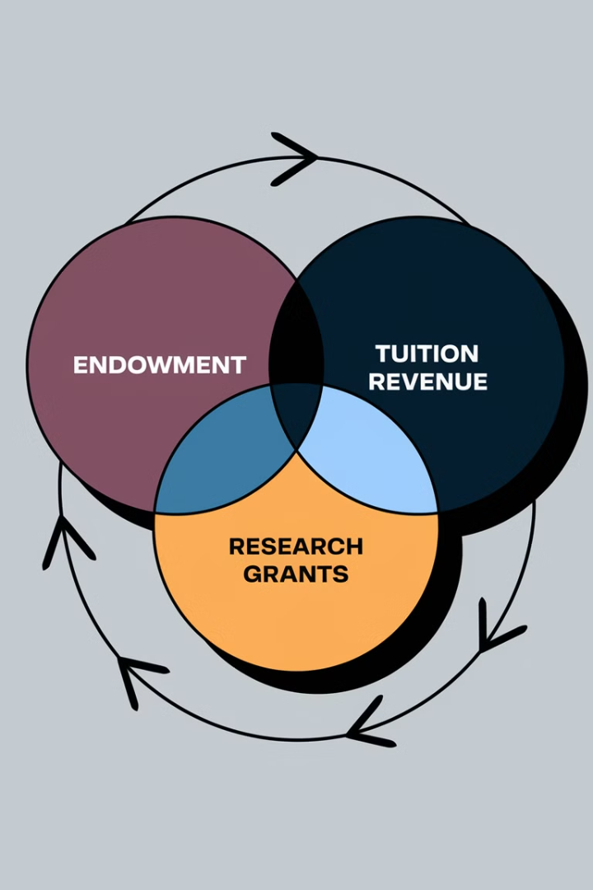
Why a New Metric Was Needed
Traditional CFI Limitations
Maxes at 3.0 but schools with perfect scores have closed.
aCFI Improvements
Removes depreciation and includes restricted funds.
Regular Data Integration
Updates from 990s, IPEDS, and closure reports.
Explore at universitydeathpool.com
Access the complete dataset and interactive tools.

Slide 8




A University Postmortem
Holt-Winters Forecasting
Predicting enrollment trends
Sobol Sequences
Analyzing parameter sensitivity
Bayesian Optimization
Identifying and weighting risk factors

Slide 9
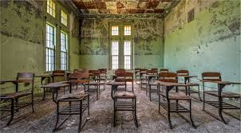
The Survivability Model
Financial (40.02%) – IRS Form 990
Academic (19.99%) – IPEDS
Market Saturation (39.99%) - Census

Slide 10
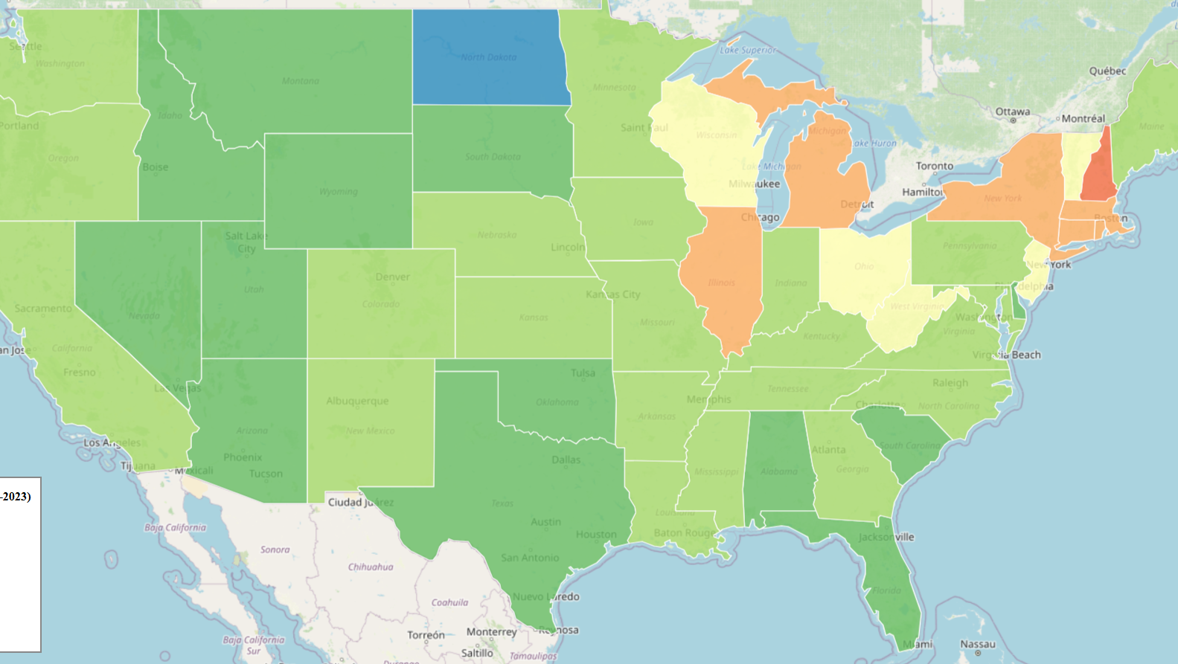
Population Trends (15-19)

Slide 11
The Results…but first…
Assumptions
Limitations
The enrollment cliff is real and measurable.
Private, not-for-profit universities are more vulnerable.
Depreciation and restricted funds distort CFI.
It may be possible to access restricted funds in a crisis.
Form 990 and IPEDS data are sufficiently reliable and available.
The model doesn’t account for leadership quality, donor loyalty, mission resilience, or alumni engagement.
Most financial and academic data are at least one year old, making real-time assessment difficult.
Some faith-based institutions may receive subsidization or protection due to religious affiliation, which may not be reflected in financial metrics.

Slide 12
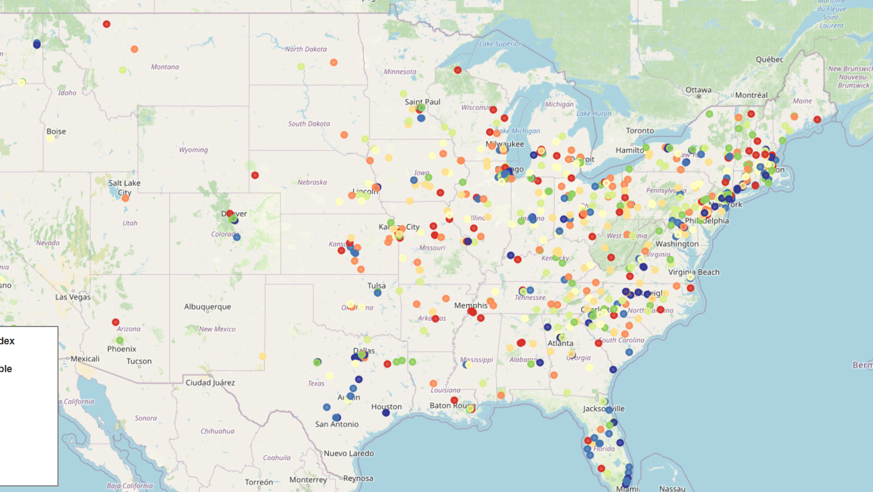
All Private, Not-for-Profit Universities

Slide 13
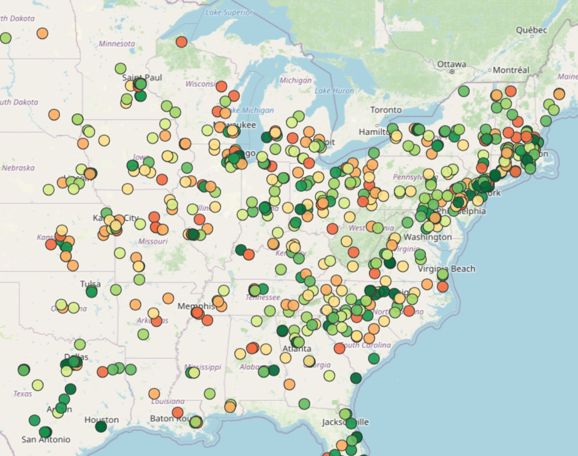
Faith-based Private, Not-for-Profit Universities

Slide 14
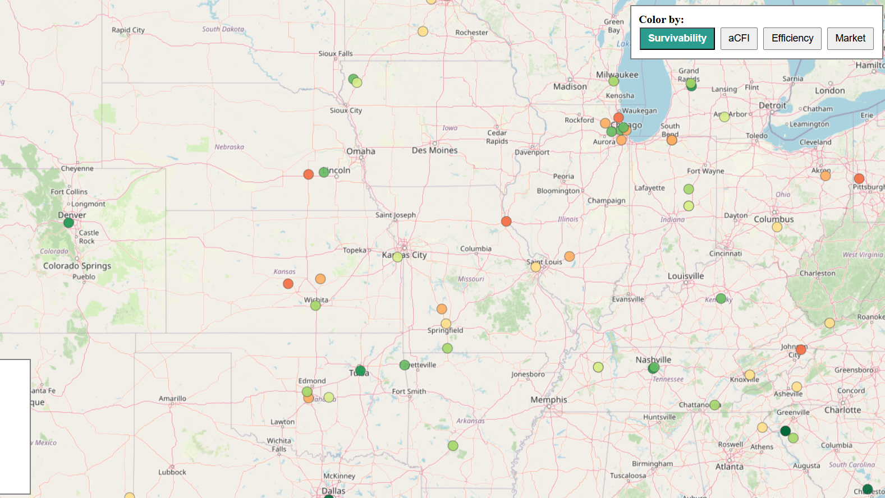
CCCU Private, Not-for-Profit Universities

Slide 15
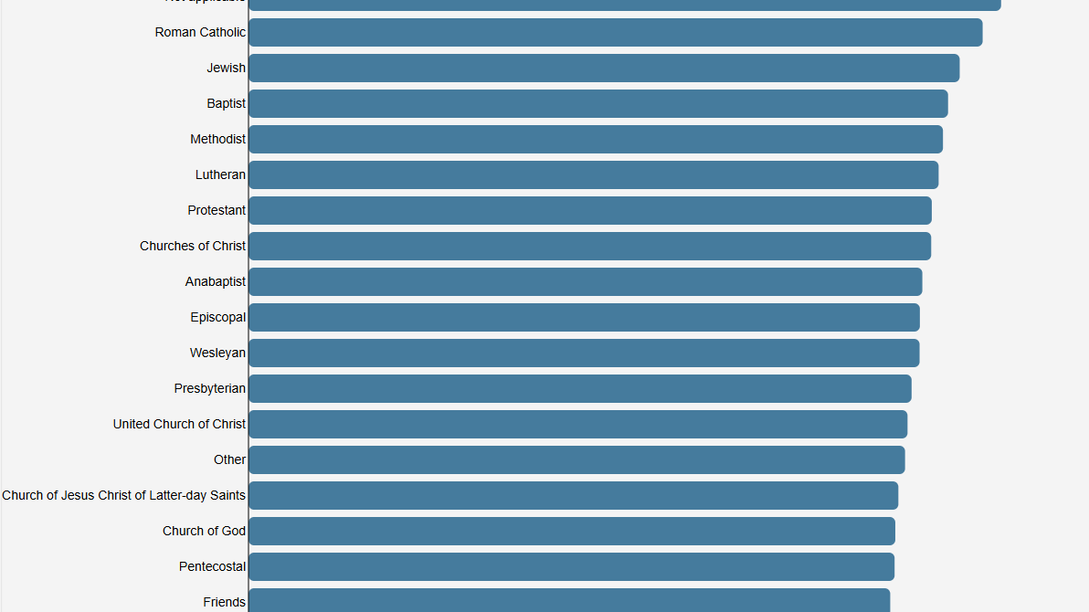
Denominational Rankings

Slide 16







The Faith Bubble
Strong Mission
Community Insulation
Clear faith identity and purpose
Self-reinforcing ecosystem
Fragile Market Position
4
Market Signal Blindness
Vulnerable to sudden disruption
Delayed response to external trends

Slide 17
What Faculty Can Do to Help Their University Survive the Enrollment Cliff
🎯 Lead with Data and Courage
- Advocate for closing unprofitable programs—even legacy ones.
- Support strategic academic consolidation and focus.
🚀 Think Like a Builder
- Create programs aligned with market and workforce needs.
- Promote certificates, microcredentials, and interdisciplinary offerings.
📲 Embrace Educational Technology
- Leverage hybrid and online delivery strategically.
- Adopt tech that improves learning: gamification, flipped classrooms, adaptive tools.
🗣️ Be Advocates Beyond Campus
- Start conversations with legislators on funding equity.
- Oppose policies that subsidize public universities only.
💡 Be Good Stewards of Resources
- Engage in retention and enrollment efforts.
- Balance quality instruction with efficient course delivery.
🤝 Promote Institutional Loyalty
- Be part of the solution. Collaborate, adapt, and lead with integrity.

Slide 18

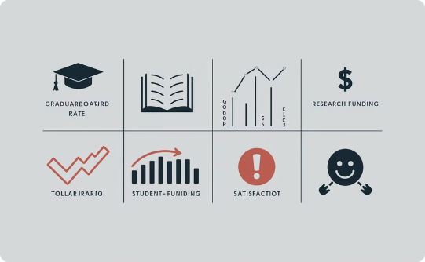

Key Takeaways
Crisis is Real
Data-Driven Solutions
Faculty as Change Agents
25% of private universities face existential risk by 2028.
The CSI model provides early warning for at-risk institutions.
Business faculty can lead institutional transformation efforts.

Slide 19
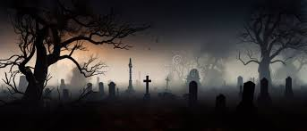
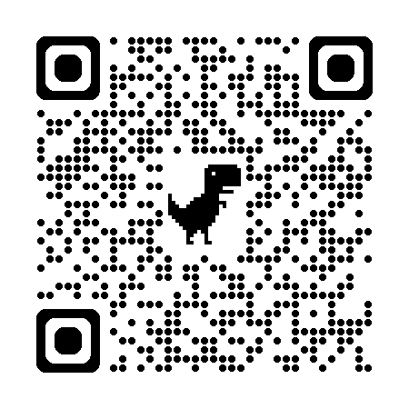
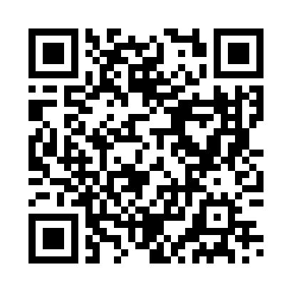
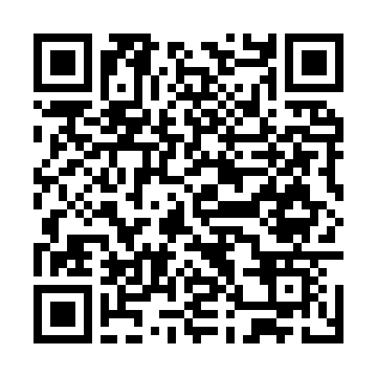
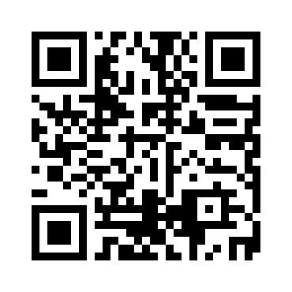
Questions? Explore the Data Yourself
Universitydeathpool.com
(please subscribe!)
National Map
Faith-Based Map
CCCU Map
Scan these codes to access interactive maps and explore the complete dataset. All resources are freely available for your research and planning.

